Slide 1
Manual and Automation Testing Trainer : Raghuveer 10 plus years of experience in IT in Manual and Automation Testing in Banking, Financial and Telecom Domain Working as QA Lead in MNC email ID :nvraghuveertrainer@gmail.com phone : 7893195479

Slide 2
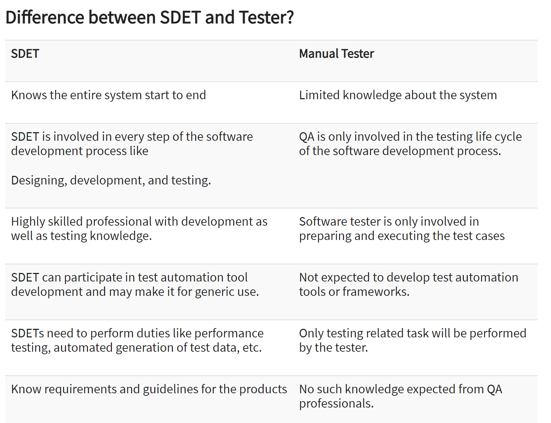

Slide 3
Manual and Automation testing
Some key benefits of Test Automation are:
Manual intervention is less, so the possibility of errors diminishes.
It ensures higher ROI on the huge investments required initially.
Automated tests make the process more reliable and the tests more dependable.
Automation helps you find bugs at an early stage.
You can test 24*7 from a remotely–held device as well.
It makes the test scripts reusable – need new scripts every time even with changes in the version of the OS on the device and the tests can recur without any errors.
Most importantly, it enables testing in volumes. For instance, it allows you to run tests on thousands of mobile devices. Now, this is impossible with Manual Testing.
Selenium is the most popularly used freeware and open source automation tool. The benefits of Selenium for Test Automation are immense

Slide 4
Benefits of selenium
Open Source
Language Support (Python, PHP, Java, C#, Ruby, JavaScript etc)
Works Across Multiple OS
Cross Browser Compatibility Testing
Supports Multiple Frameworks and Languages
Cross-Device Testing
Community Support
Easy to Implement
Mouse Cursor and Keyboard Simulation

Slide 5
Hybrid Framework from scratch
TestNG
Data Driven
Page Object Model
Keyword Driven
BDD cucumber
Implement by following OOP’s concepts
Code is integrated with CI/CD : Jenkins
Git hub

Slide 6
->You will be able to design the hybrid framework from scratch.
->Everyday job openings
->Mock Interviews
->Resume Preparation
QA

